Slide 1

Asset Owner Platform with AI project
w w w w i z v i s i o n c o m

Slide 2

Agenda
Introduction to the Project
Objectives and Key Features
High-Level Architecture Overview
Students Deliverables
Selection of AI Tools

Slide 3
Introduction to the Project
What is the generic e-Bidding Engine?
A platform enabling real-time auctions for B2B and B2C scenarios
Incorporates AI for predictive analytics and automation
Property sales and rentals.

Slide 4
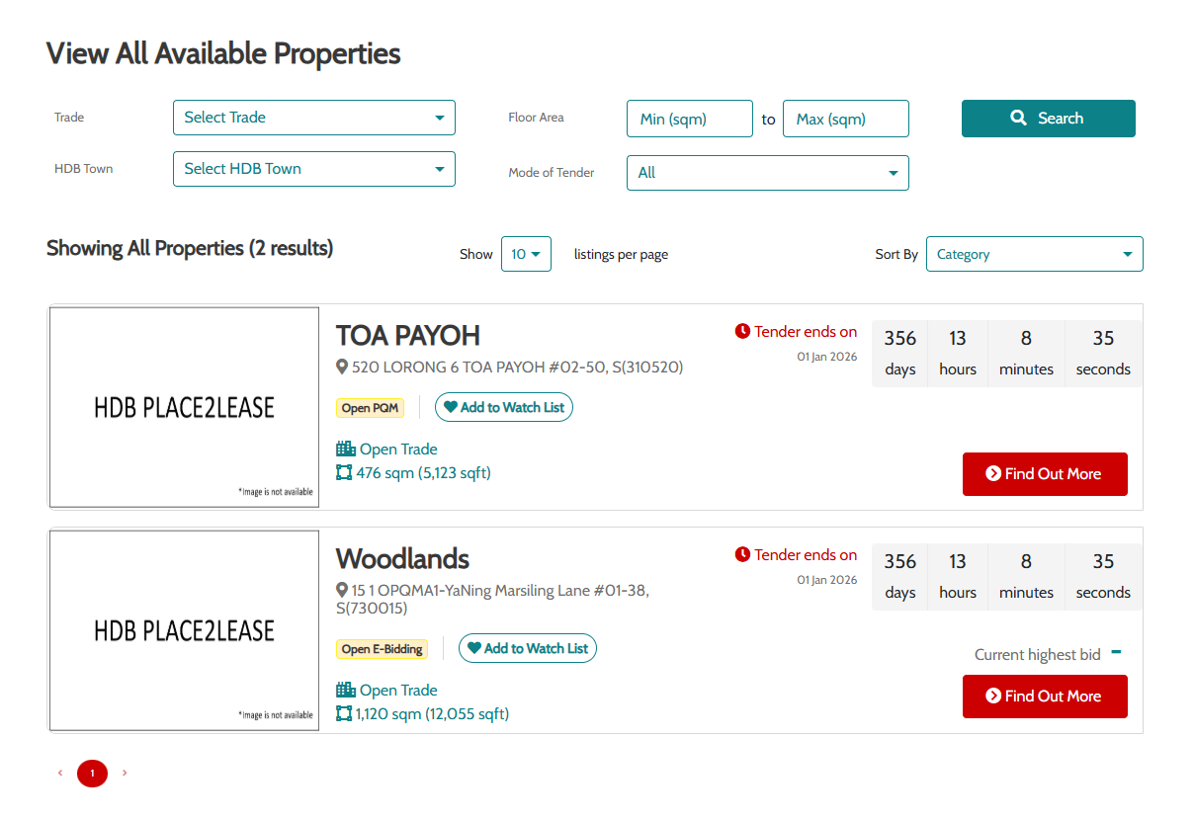
HDB Place2Lease Website

Slide 5
High-Level Architecture Overview
System architecture
Frontend: HTML5, CSS, JavaScript (Angular).
Backend: Node.js, Java (Spring Boot).
AI Engine: Predictive price analytics, NLP, property valuation models.
Data Storage: RDS, NoSQL, and cloud-based solutions.
Real-Time Communication: WebSockets for bidding updates.

Slide 6
Objectives
Predictive Analytics
Property price forecasting
Market trend analysis
Rental yield prediction
Demand forecasting
NLP
Chatbots for customer inquiries
Text analysis for property reviews
Generate legal property contracts and agreements.

Slide 7
Deliverable Requirements
Research and Recommend
Which AI model and framework to use
Which AWS services required
Proposed solution requirements
Deploy on Docker
Capable of version control and tracking

